Slide 1
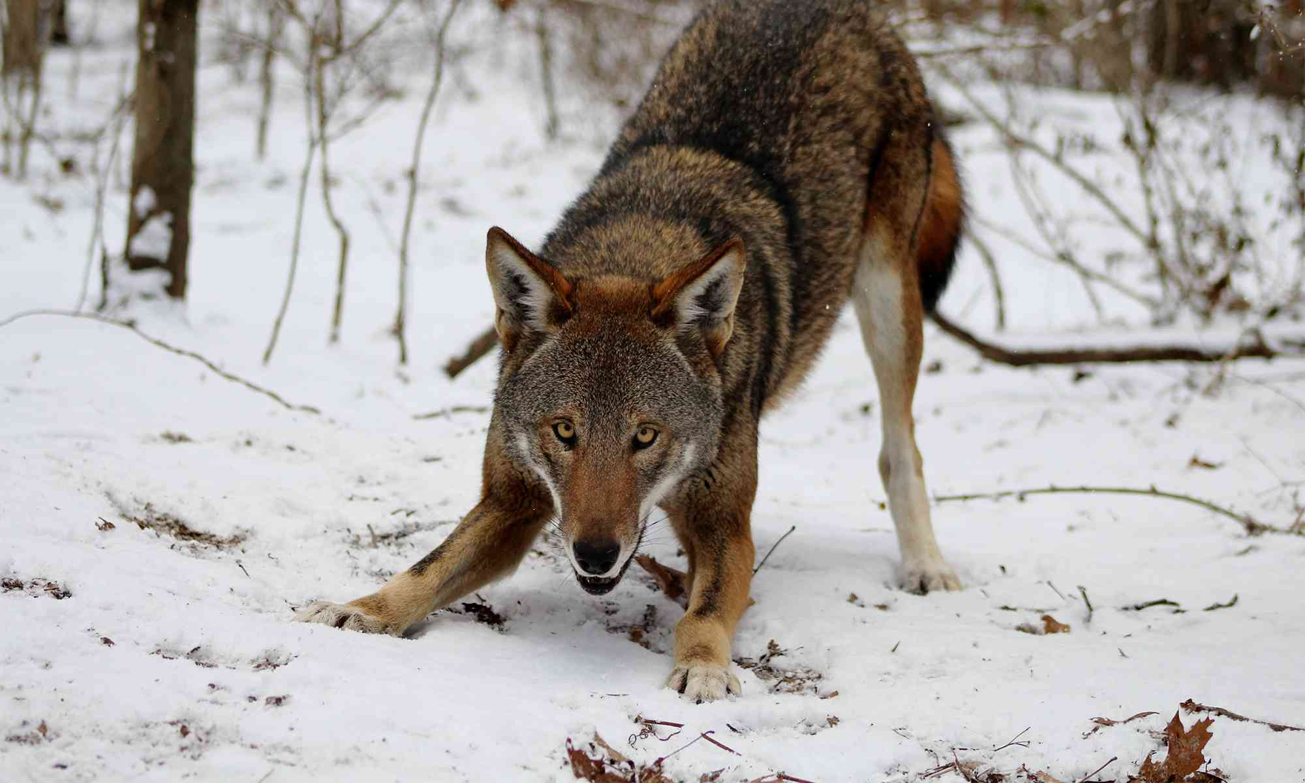
Comparing Canid Skull Morphology in R
Bio 5202: Analysis Tutorial
Pat Bailey
Photo: Rebecca Bose / Wolf Conservation Center

Slide 2

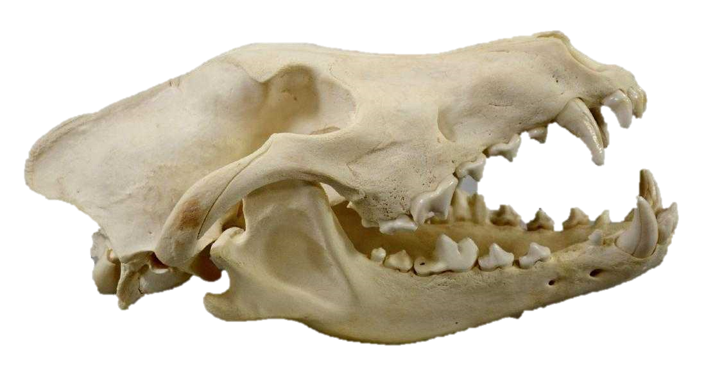
1
Research Questions
Are there differences in skull morphological characteristics between populations of Canis?
Is there an overlap between species?
Population A
Population B
Species A
Species B
Skull: iStock via Satirus

Slide 3
2
Objectives
Generate usable shape data from available Canis skulls
Develop functional R code for analysis of landmark-based morphometrics:
Data input + digitization
Statistical transformations + analyses
Data visualization

Slide 4
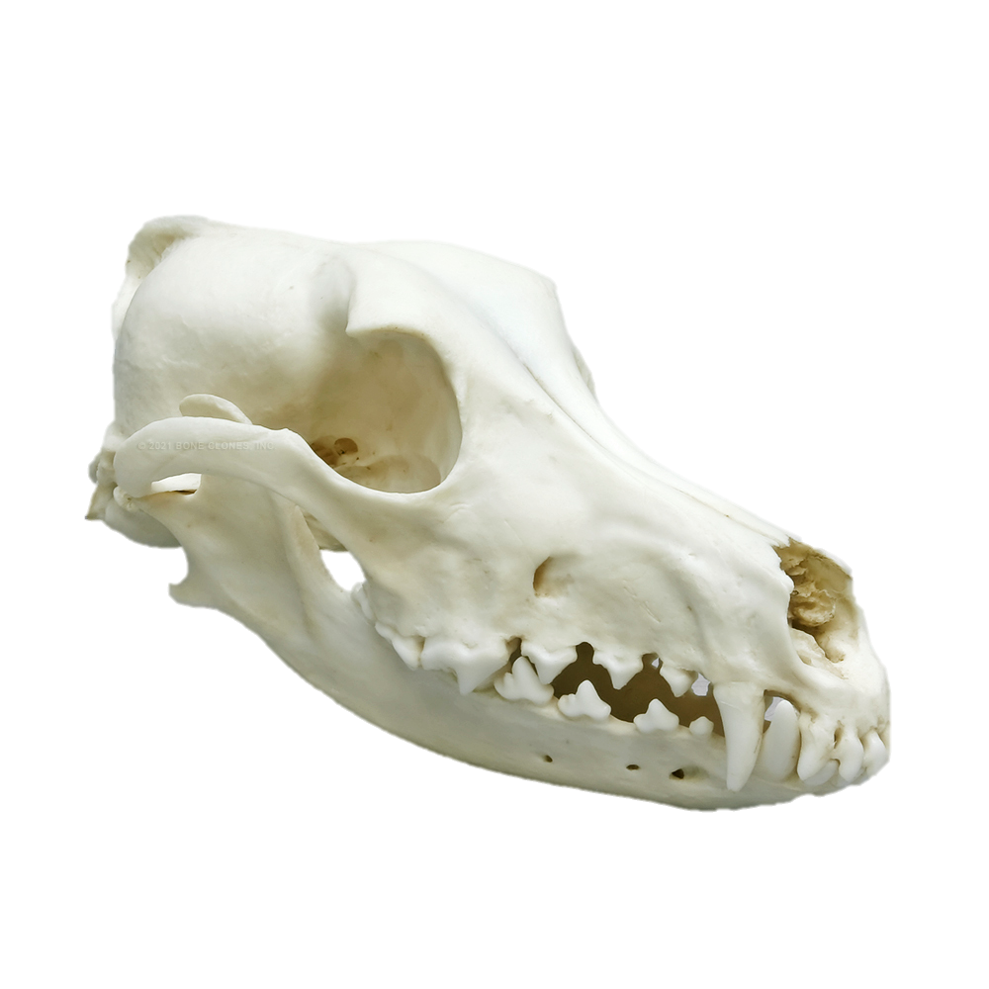
3
3D Morphometrics
Goal: quantitatively assess biological shape, shape variation, and shape covariation.
3D geometric landmarking
(x, y, z)
Reference skull
Target skull
Skull: Bone Clones, 2021

Slide 5
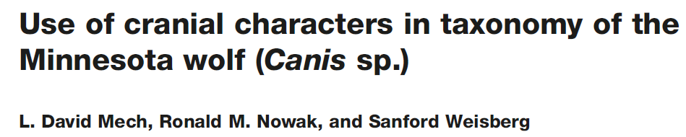
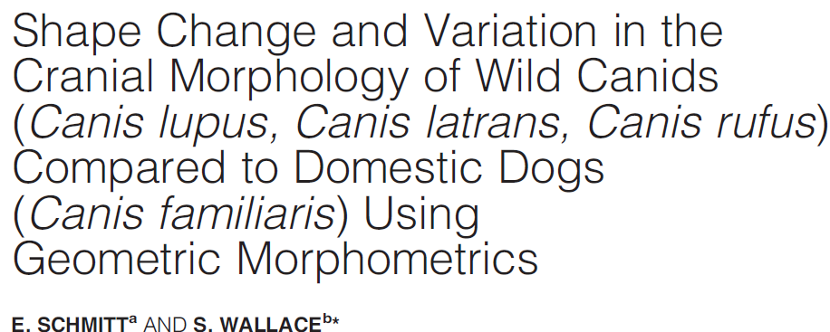
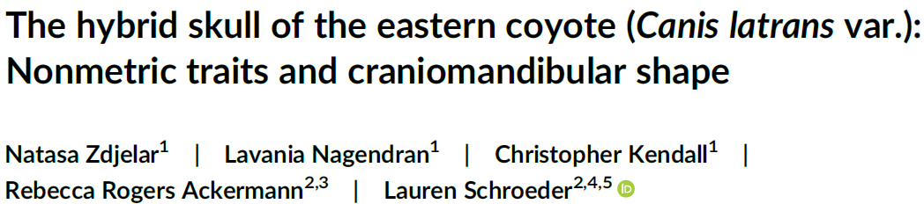
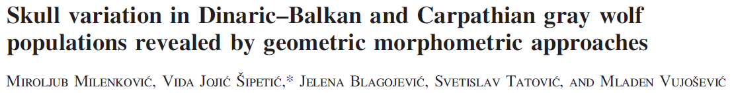
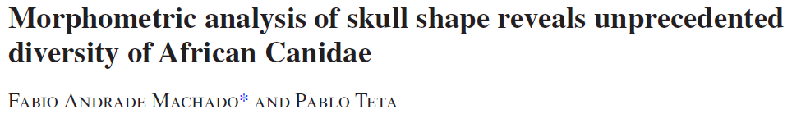
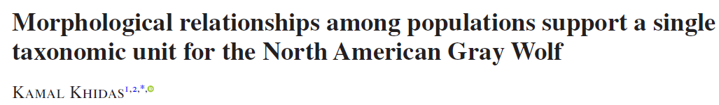
4
Morphometrics in Canid Research

Slide 6
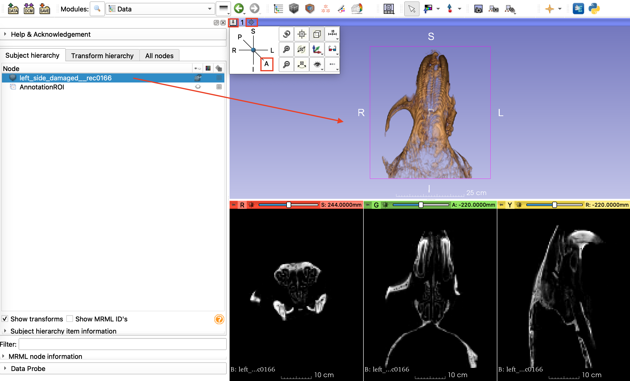
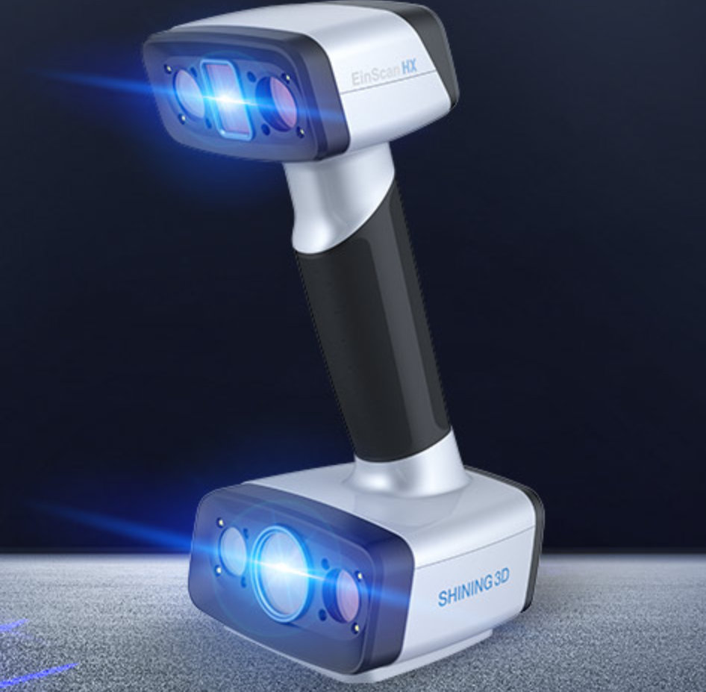
5
Analysis Tutorial: Preparing the Data [3D Slicer]
STEP 1: data collection
STEP 2: data configuration
3D scanner: EinScan HX

Slide 7
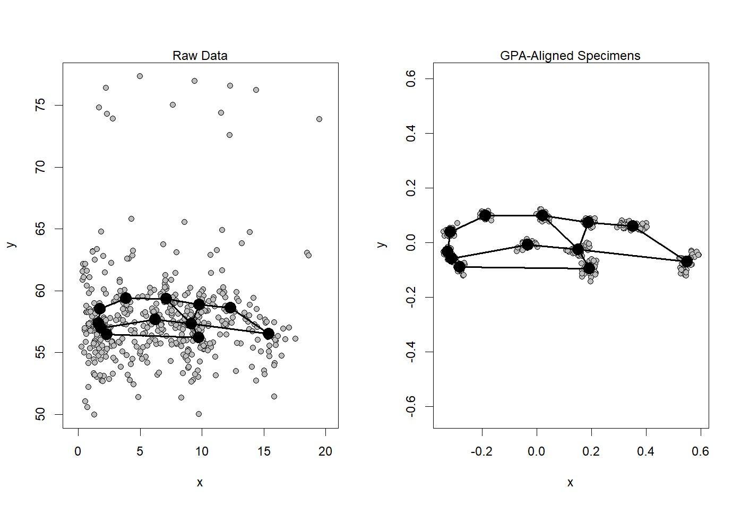
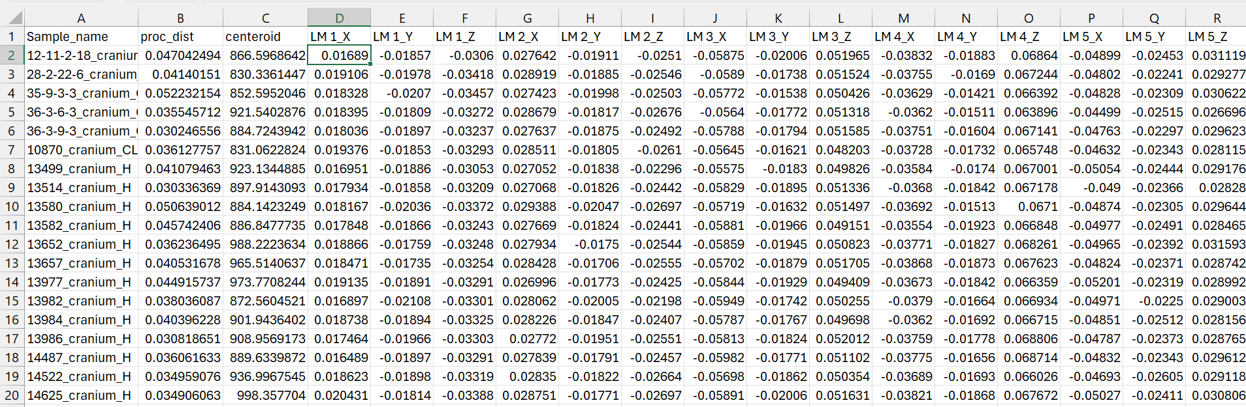
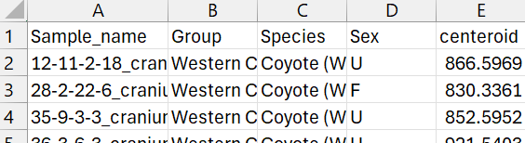
6
Analysis Tutorial: Preparing the Data [3D Slicer]
DATA EXPORT AS CSV
STEP 3: GPA
Landmarks
804 landmarks
across 148 skulls ~ 119,000 observations
Classifiers
Group + species

Slide 8
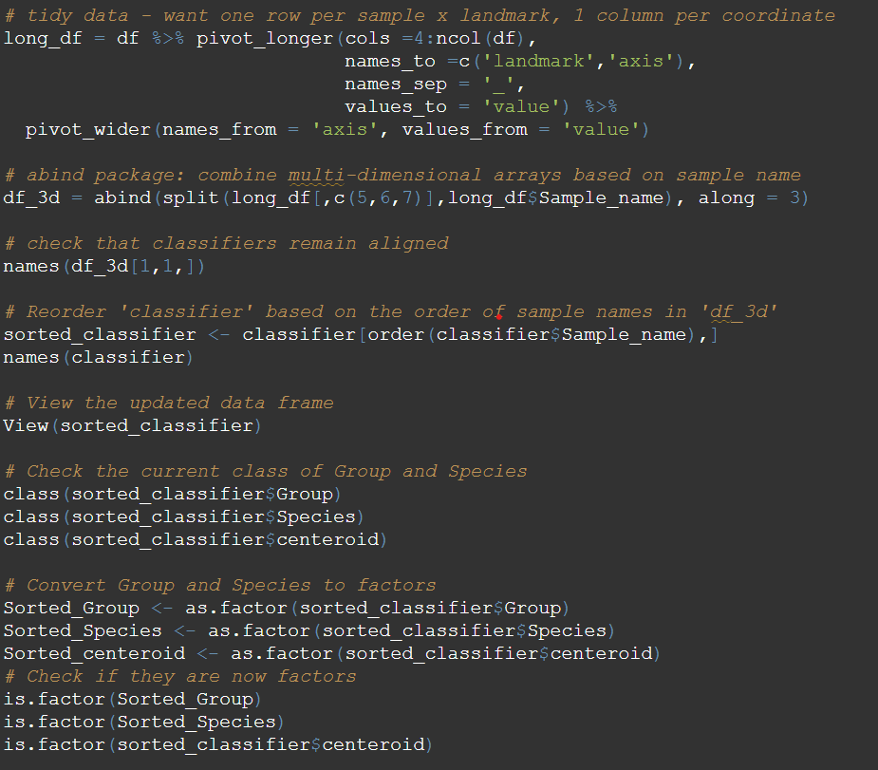
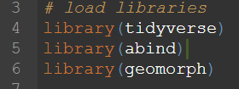
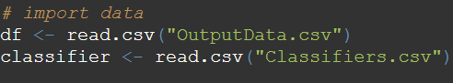
7
Analysis Tutorial: R
STEP 1: packages
STEP 2: data tidying + format
Data tidying
Data format
Spatial data
3D slicer
Variables

Slide 9
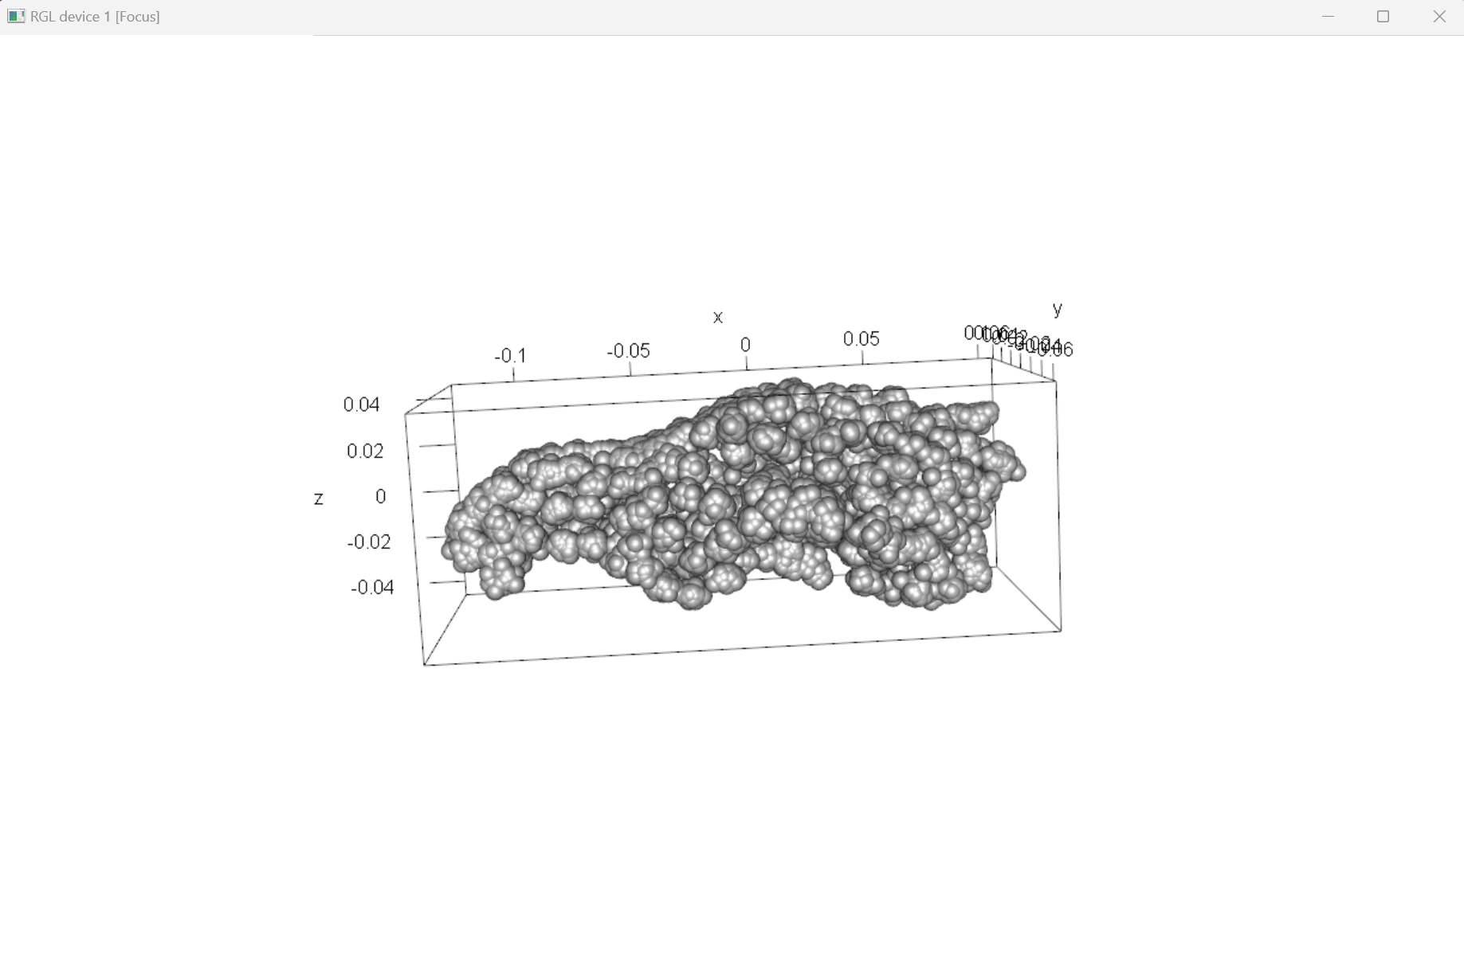
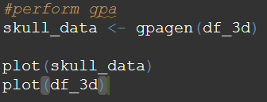
8
Analysis Tutorial: GPA

Slide 10
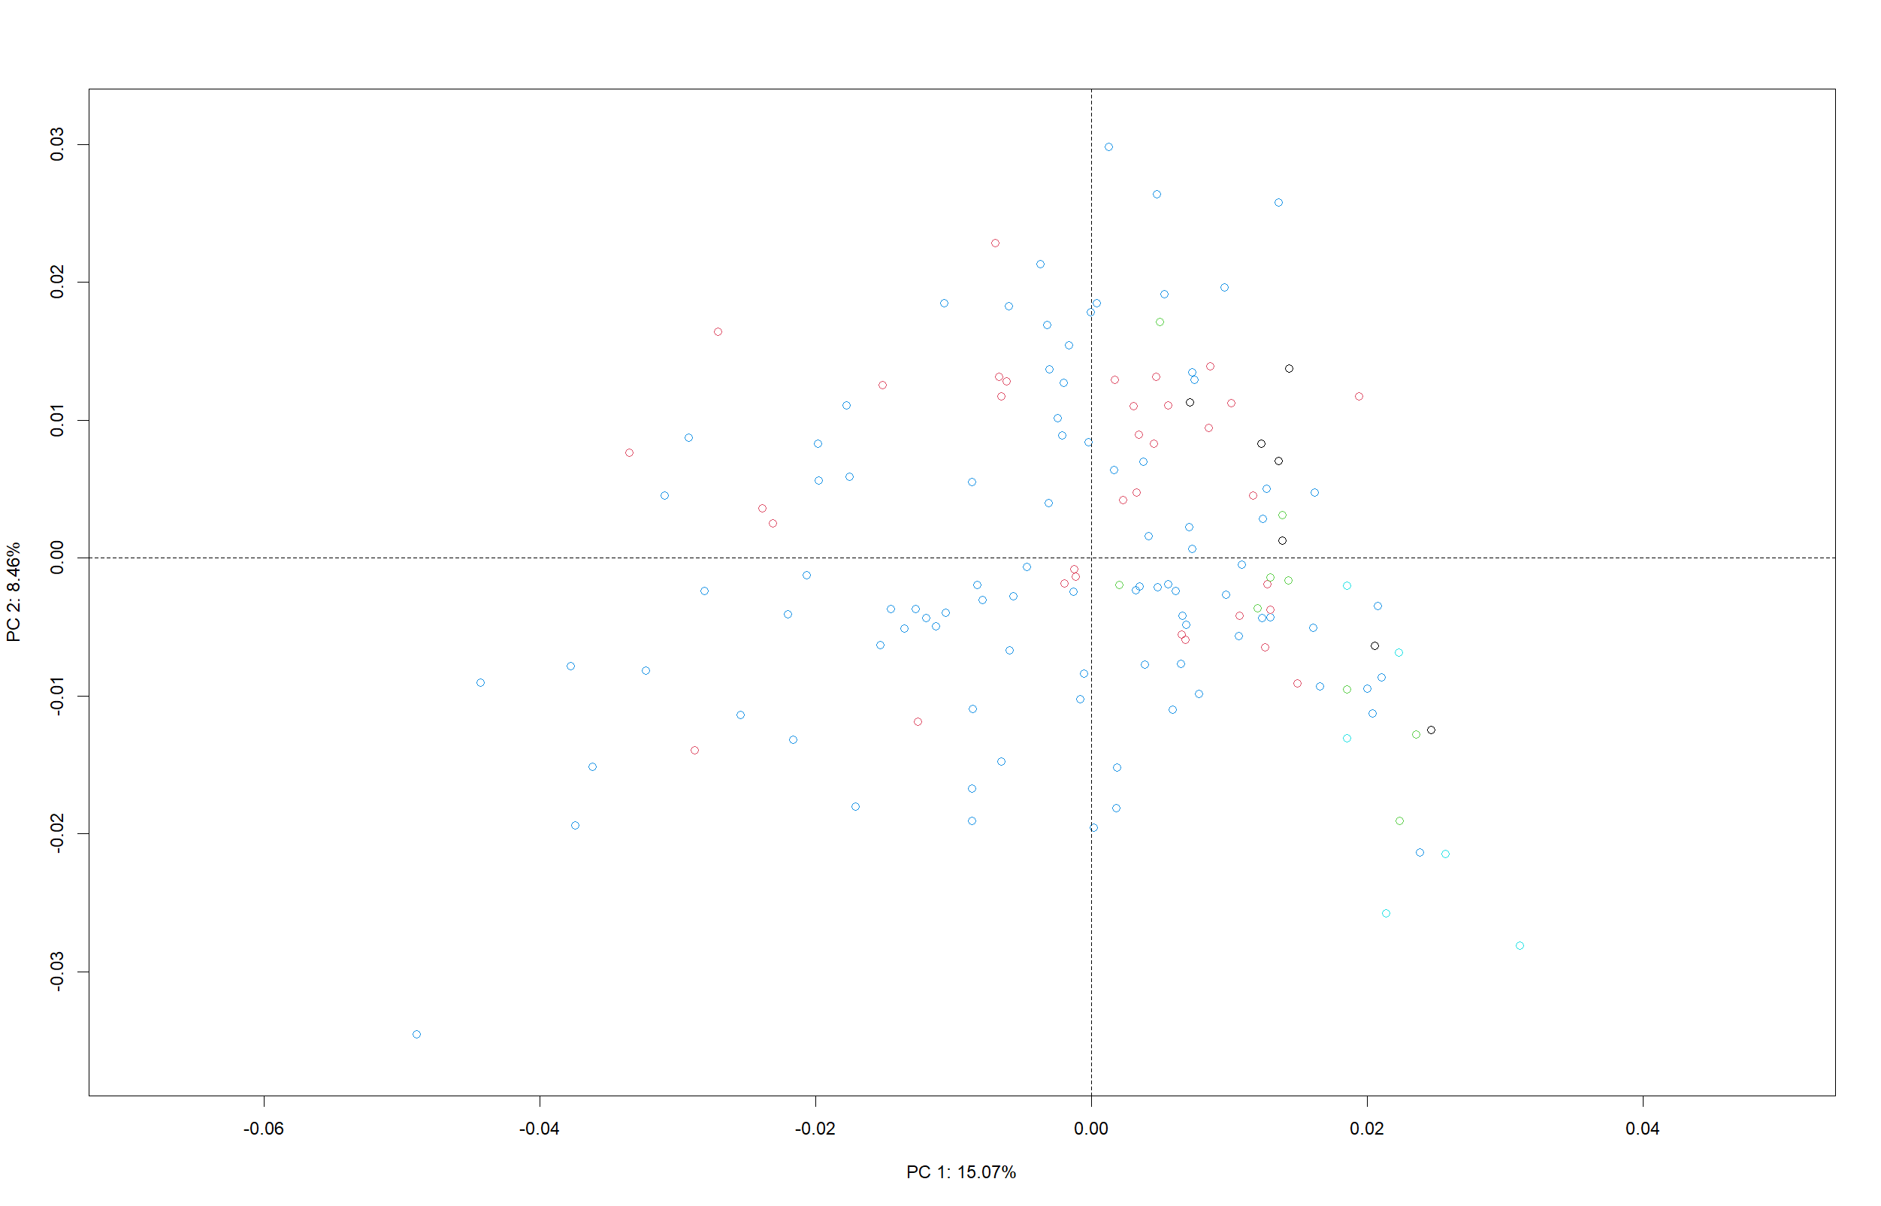
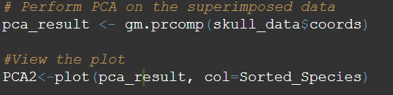
9
Analysis Tutorial: PCA

Slide 11
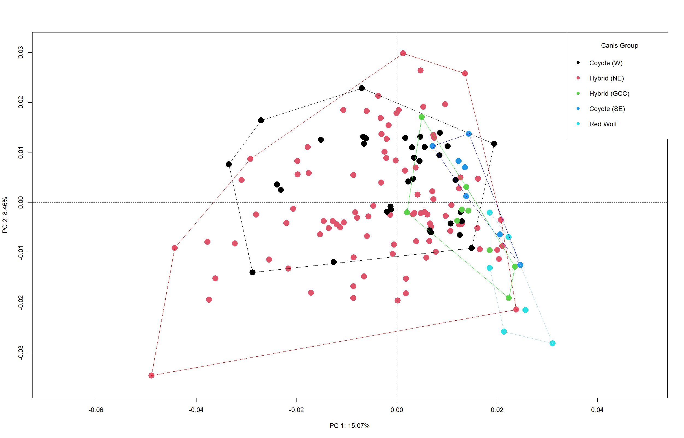
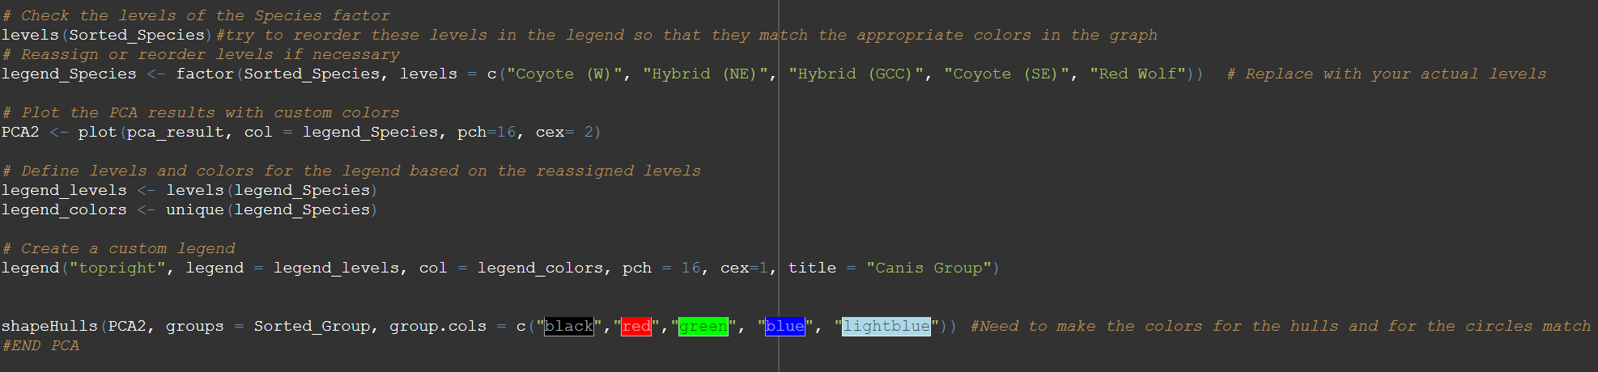
10
Analysis Tutorial: Better PCA
Research questions:
1. Different Skull morphology b/t populations?
2. Overlap b/t species?
YES
YES

Slide 12
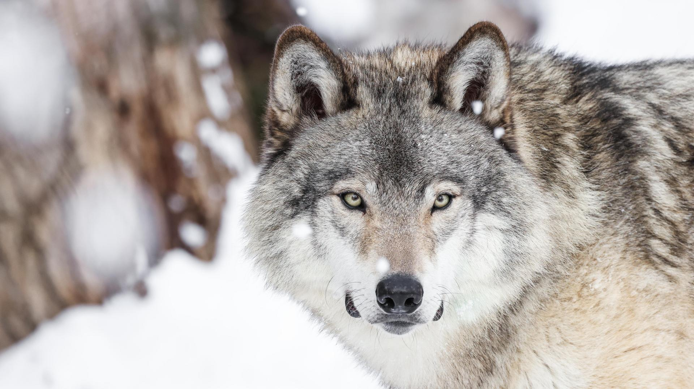
Thank you!
Questions?
Photo: Wilder Institute / Calgary Zoo, 2024

